Slide 1
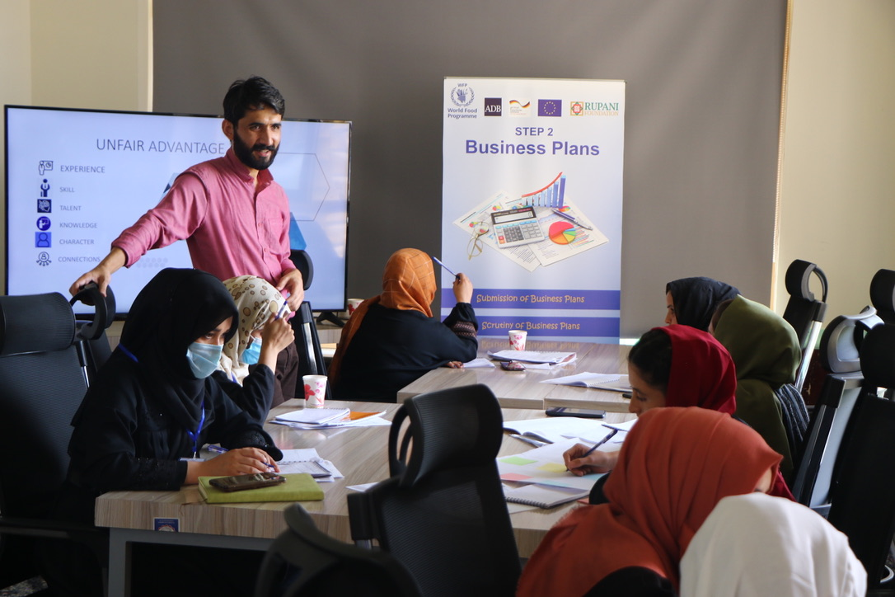

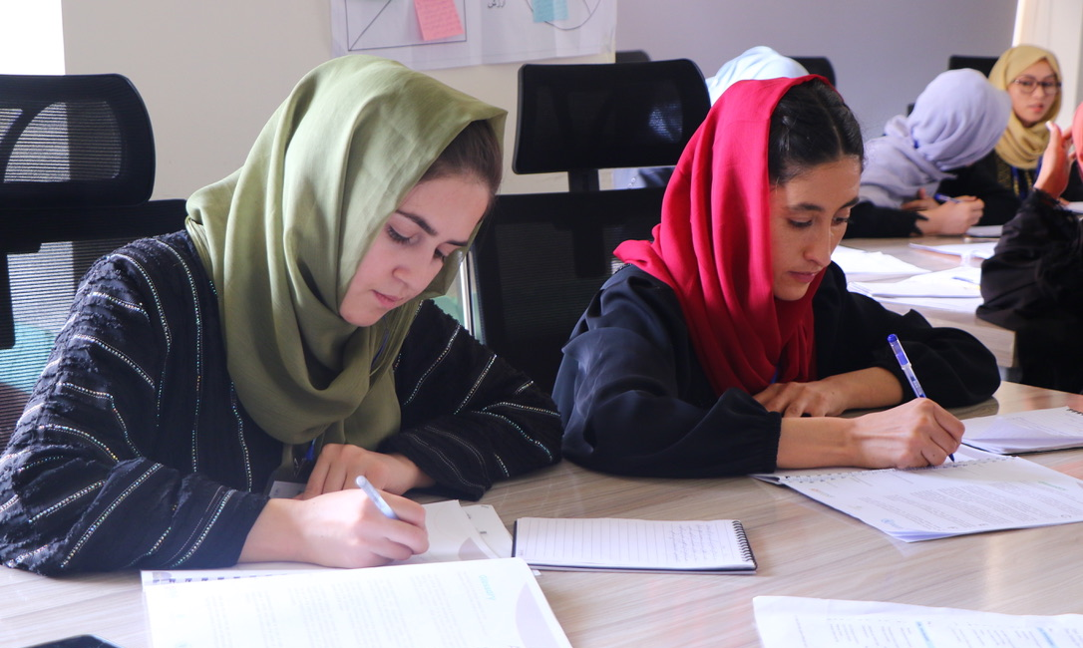
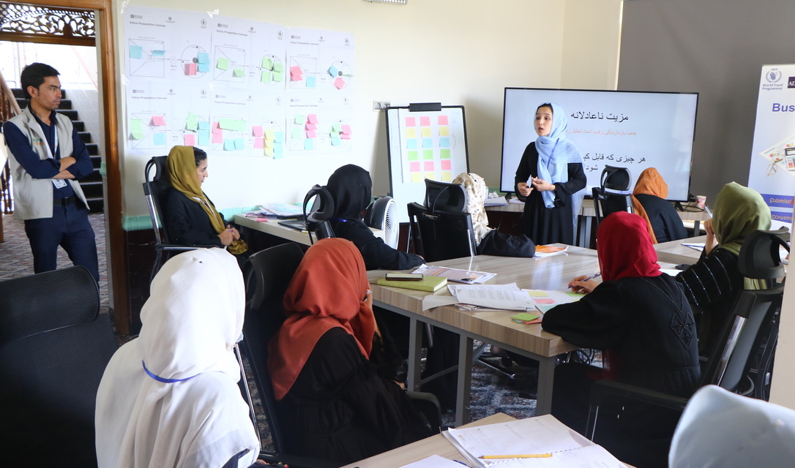
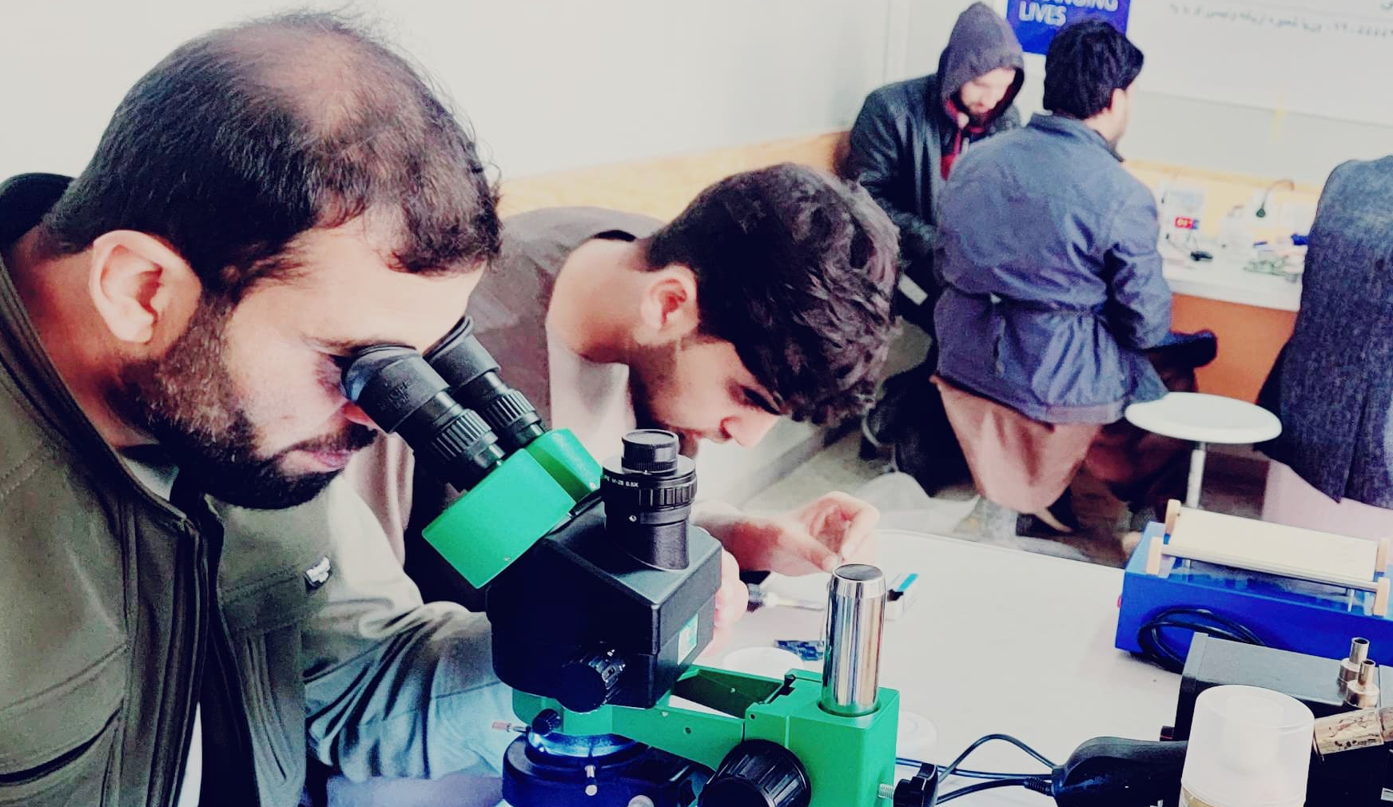
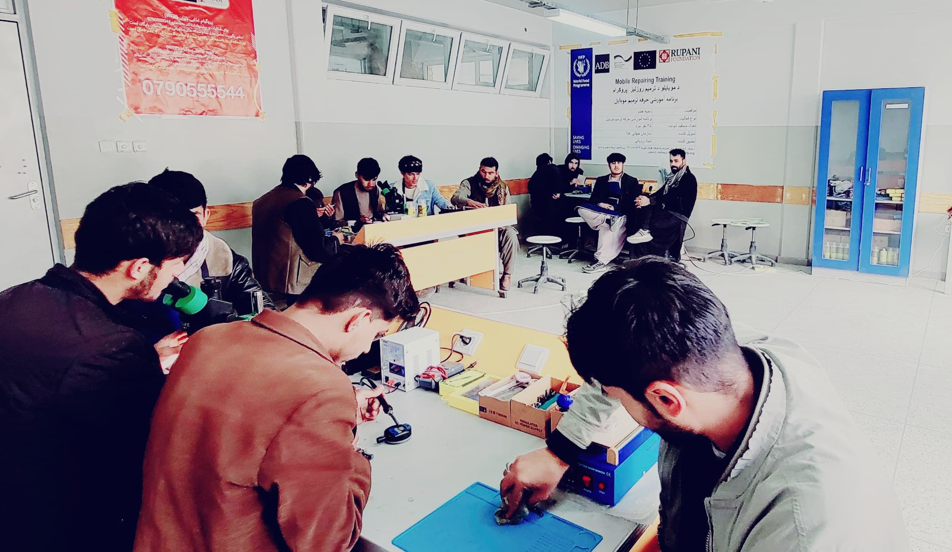

Future Skills Hub & Incubation Center
Inspire Ideas

Slide 2


About the Future Skills Hub
Welcome to Future Skills Hub, your launchpad for success. We offer a diverse range of services tailored to empower educated youth with core digital skills as well as startups and entrepreneurs, with comprehensive business and enterpenurship skill. Our dedicated team is here to support you with web development and software solutions, ensuring you have everything you need to thrive in the competitive business landscape. Join us today and let's turn your dreams into reality.
Startup Creation
Early Stage
Expansion
Pre-Incubation
Entrepreneurship Training
Business Plan Elaborations
Incubation
Hosting (Co-Workspace)
Coachign and Mentoring
Post Incubation
Innovation Diagnostics
Technology Support
Advance Training
Advance Business Planning
Access to Finance
Business Awards
Clustering
Business Development
Acceleration
Technical Support to develop initial Business Plan
Pitches and Selection for Incubation
Our Goal
At the Future Skills Hub, our goal is to foster innovation, nurture entrepreneurship, and drive economic growth. We provide a dynamic and supportive ecosystem where aspiring entrepreneurs and startups can transform their ideas into thriving businesses. Additionally, we offer state-of-the-art training halls and conference rooms, equipped to facilitate workshops, seminars, and conferences.

Slide 3


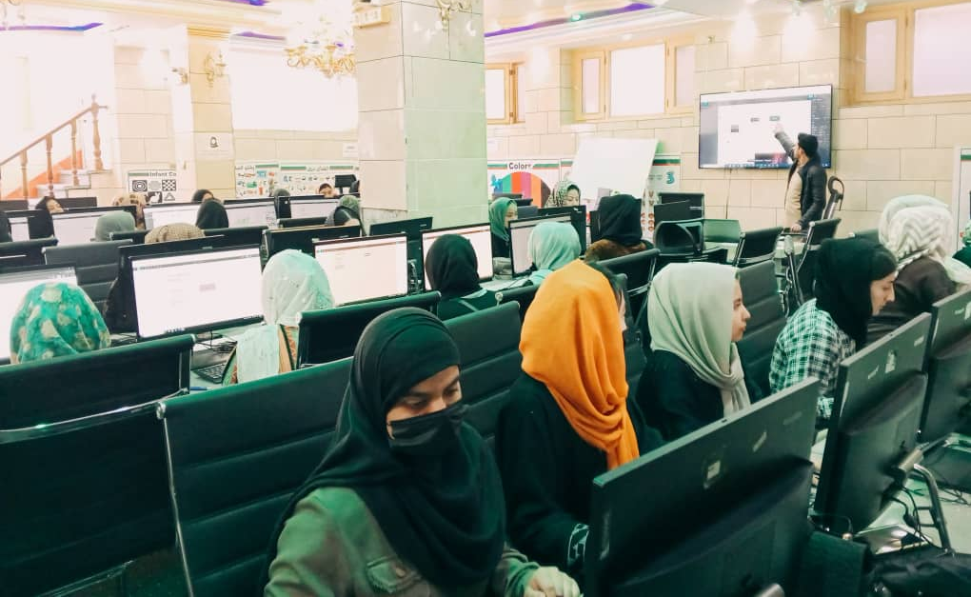

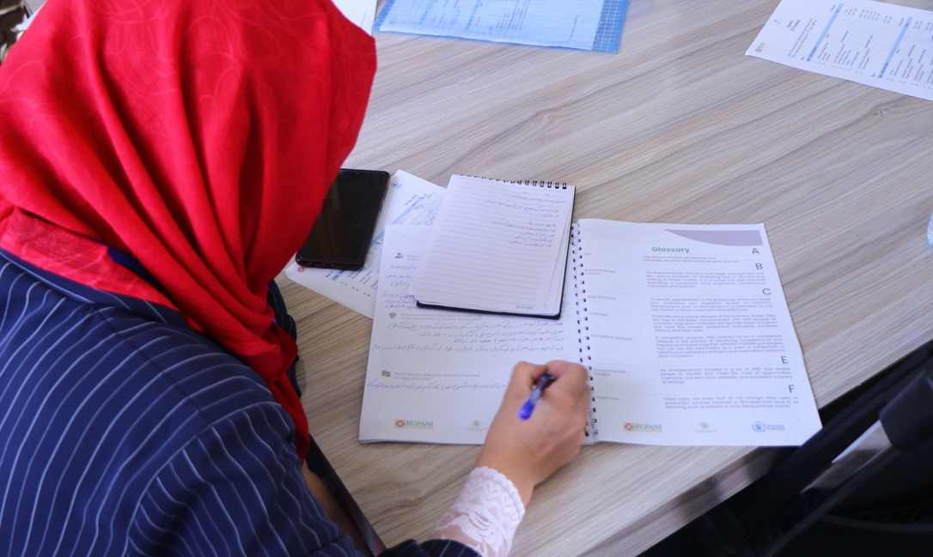

Sectors in Focus
Future skills/IT
Education (ECD)
Gems & Jewelry
Auto-mechanics
Livestock value chains
Handicraft enterprises
Agriculture & Poultery
Support
Co-Working Space with dedicated desks
High-Speed Internet Connection
Uninterrupted Power Supply
Legal Support
Business Advisory
Network Support
Training and Development
Mentorship
Access to micro-finance loan
Achievements (Since 2021)
4100+ people Trained
87+ Business enterprises Created
250+ Jobs Created
7488+ Hour's training & mentored
4100+ Youths Inspired
Partners

Slide 4
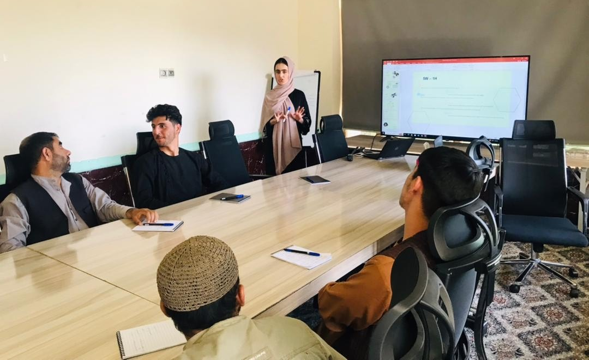
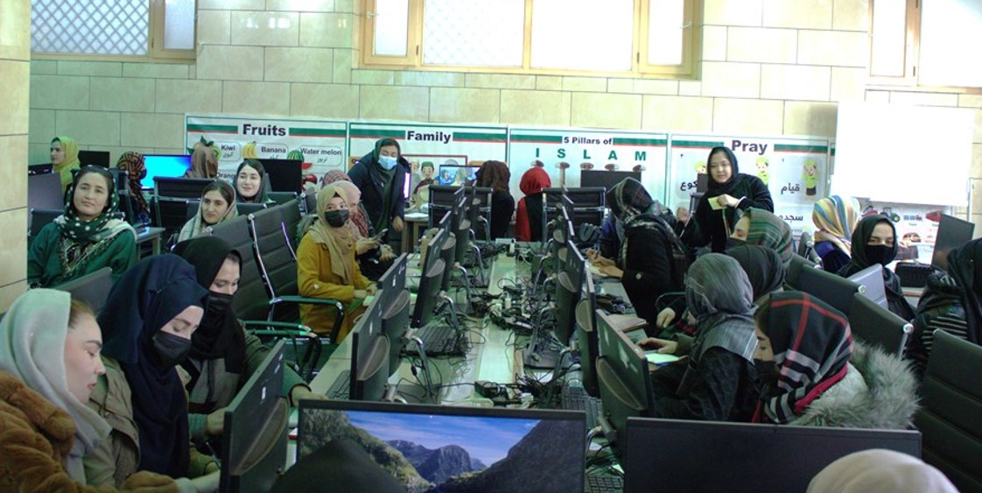
Techchnical &
Vocational
Trainings
Our Course Offerings Include;
Front-End and Back-End Development for web applications,
Python Programming for versatile software development,
Digital Marketing to thrive in the digital landscape
UI/UX Design for creating user-friendly interfaces
Video Editing for multimedia content production,
Training of Trainers program.
These courses and programs provide students with hands-on learning, expert guidance, and industry-relevant knowledge, enhancing their employability and fostering personal and professional growth
Digital Skills Training
Digital skills are vital for 21st-century economic development, enabling individuals and communities to harness technology's power, connect globally, and drive innovation. At our Future Skills Hub & Incubation Centre in Kabul, Afghanistan, we're dedicated to empowering Afghan youth. Through our comprehensive Skills Development Program, we equip students with practical skills for enhanced employability and personal growth. Our hub offers a cutting-edge curriculum, expert guidance, modern facilities, industry connections, diverse course offerings, and a vibrant learning community, contributing to the nation's economic prosperity.
Program Highlights
Hands-On Learning: Practical, experiential sessions for immediate skill application.
Comprehensive Curriculum: Covers teaching methods, curriculum design, and more.
Expert Instructors: Guidance from experienced educators
Peer Learning: Collaborative environment for mutual knowledge sharing.
Practical Experience: Develop, deliver, and refine training sessions.
Certification: Recognizes the ability to train and mentor effectively.

Slide 5

CONTACT US
House No 5, Street 13, Qala-e-Fathullah
Kabul 1007, Afghanistan
Ph: 5555435433
Cell: 0093-796291322
info@rupanifoundationaf.org

