Slide 1

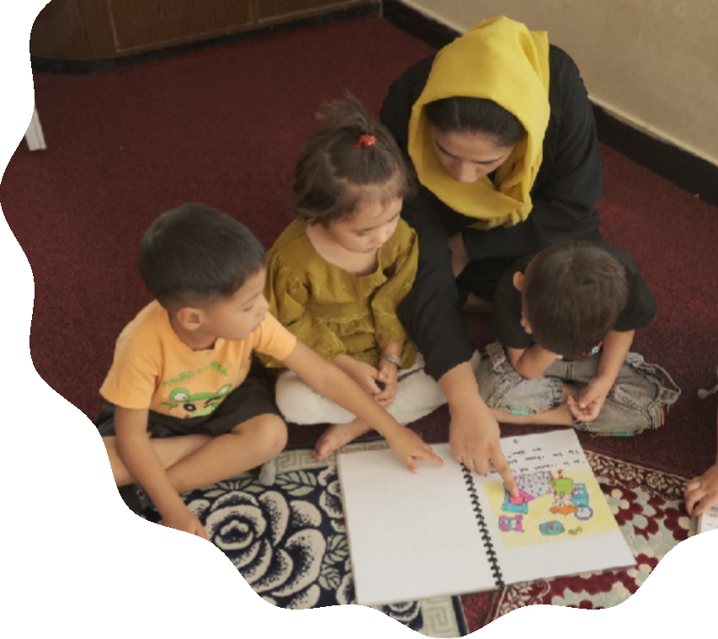


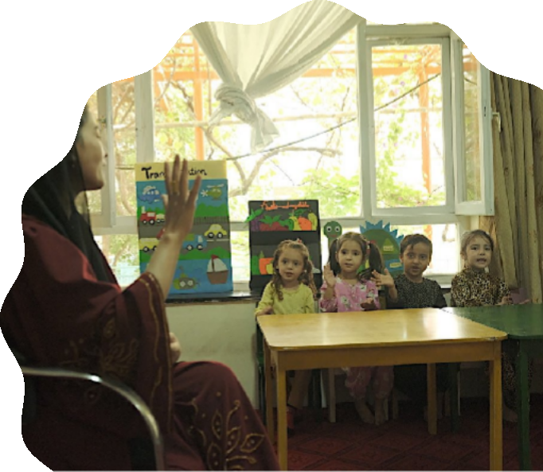
NIHĀL
PRE-SCHOOL PROGRAM & ECD RESOURCE CENTRE
Nurturing the Future, from the Very Start

Slide 2
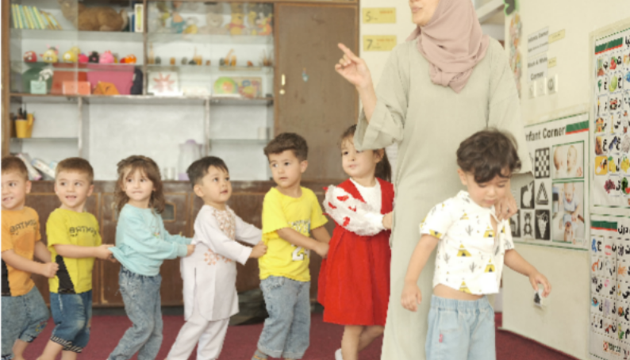
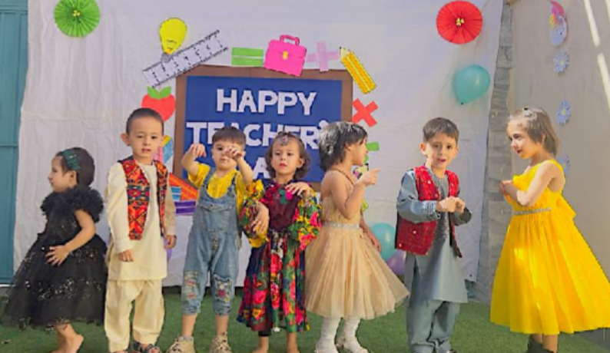
A HEALTHY START FOR A BRIGHTER FUTURE
Every child deserves the best possible start in life. Nihāl Early Childhood Development (ECD) Program is the flagship initiative of the Rupani Foundation, dedicated to optimal development of children from prenatal to 6 years old.
We believe that a child's earliest years are the most crucial. Our unique, holistic model doesn't just focus on the child—it embraces the entire ecosystem around them. We engage:
Newlywed couples & pregnant women
Parents & grandparents
Children themselves
By creating harmony within the family and providing essential knowledge, we ensure every child is nurtured during this critical window of opportunity.

Slide 3
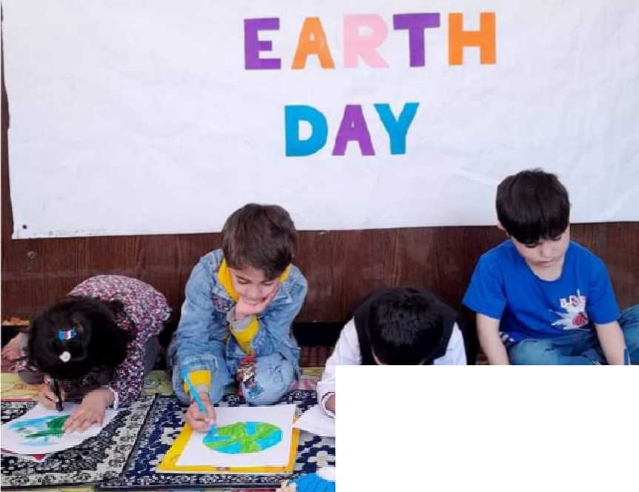
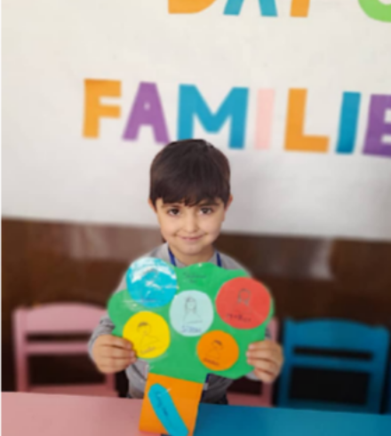
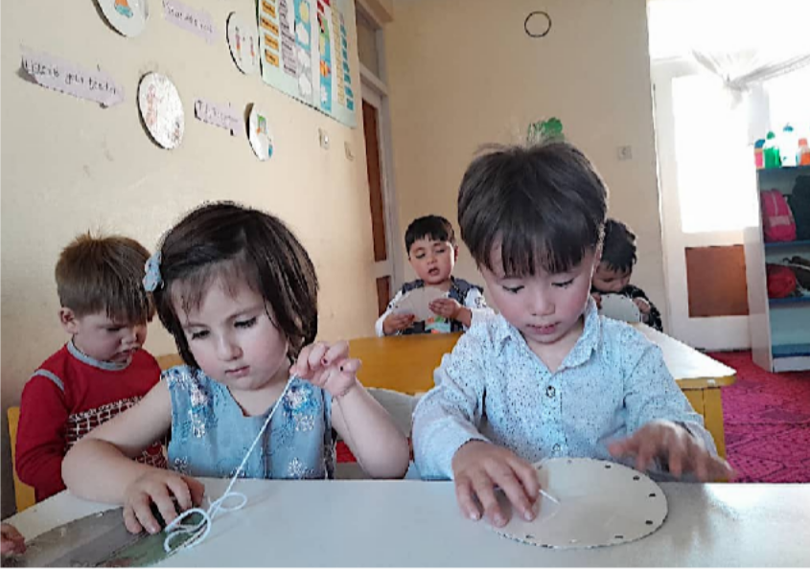
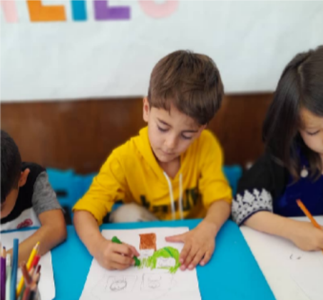
OUR UNIQUE, COMPREHENSIVE MODEL
Our approach is guided by the globally recognized Nurturing Care Framework (WHO, UNICEF, World Bank). We follow a milestone- based curriculum built on five interconnected pillars:
Good Health: Ensuring prenatal care and healthy early childhood.
Adequate Nutrition: Promoting proper nutrition for growth and brain development.
Security & Safety: Creating a protected and stable environment within our ECD centers.
Opportunities for Early Learning: Stimulating cognitive, physical, social and emotional growth through play.
Responsive Caregiving: Empowering parents and caregivers with nurturing

Slide 4
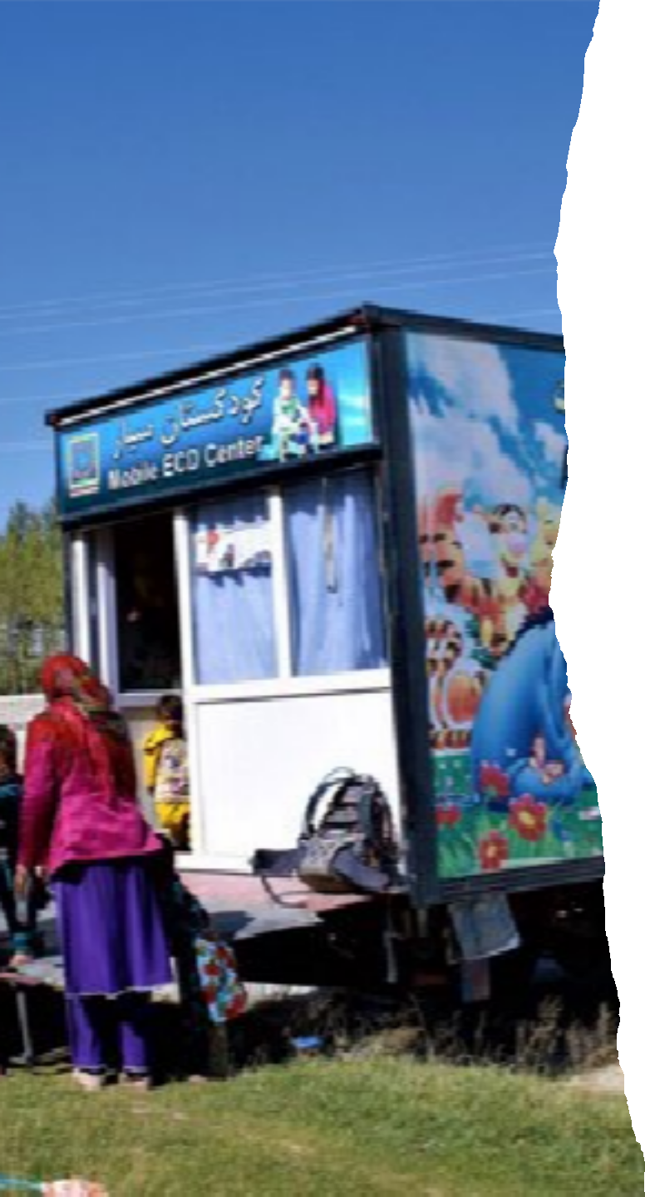
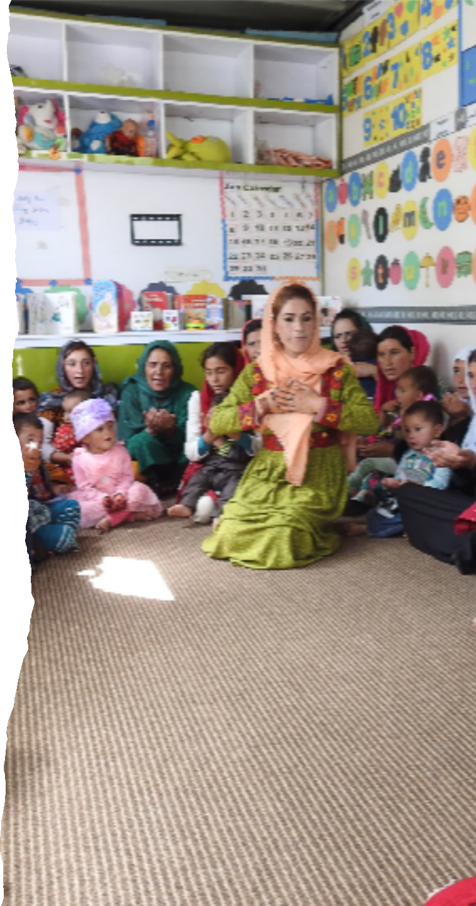
OUR REACH ACROSS AFGHANISTAN
To bring this model to life, we use a range of flexible delivery methods:
ECD Resource Centre, Kabul: A fully equipped hub for training and learning.
13 ECD Centres in Kabul and Badakhshan with fully trained and equipped teams, run by Rupani Foundation.
Mobile ECD Centres reaching 8 remote villages in Ishkashim district of Badakhshan.
31 Private ECD Centres in Kabul and Faizabad, run as sustainable private enterprises by teachers trained and supported by Rupani Foundation.
Home-Based Programs through Family Support Motivators-FSMs home visits for personalized, family-focused support.

Slide 5
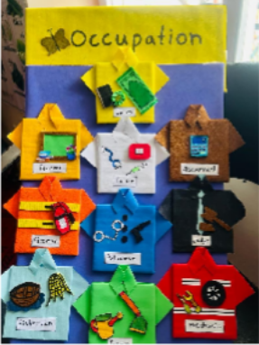
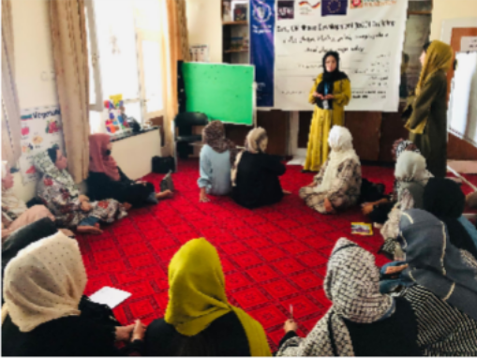
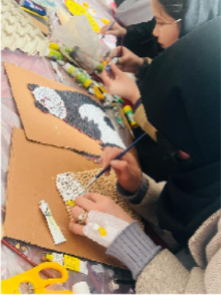
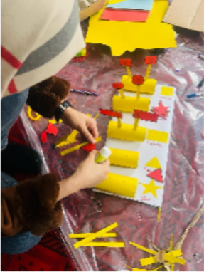
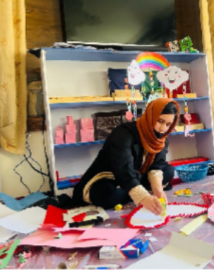
SKILLS TRAINED
PEDAGOGICAL FOUNDATION:
Integrated Approaches: Practical application of the Nurturing Care Framework
alongside High Scope (active
participatory learning) and Montessori (child- centered, self-directed activity) methodologies. Holistic Child Development:
Deep understanding of developmental milestones from birth to age 6 across cognitive, physical, social, and emotional domains.
TEACHING COMPETENCIES: | CHILD HEALTH & WELL- BEING: | ASSESSMENT AND EVALUATION:
Classroom Leadership: | Nutritional | Child Assessment: Conducting
Effective teaching methods, | Foundations: | ongoing, observational assessments to
positive discipline, and | Principles of age- | track individual child progress and
classroom management | appropriate nutrition to | tailor learning support.
strategies for diverse learning | support healthy growth | Classroom Evaluation: Methods for
environments. | and brain development. | reflecting on and assessing overall
Curriculum Planning: | Mental Health | classroom effectiveness and learning
Skills in developing, | Awareness: | outcomes.
implementing, and evaluating | Techniques to foster | Sustainability and
thematic and sequential lesson | socio-emotional well- | Entrepreneurship:
plans. | being, resilience, and | Business Skills: Entrepreneurship
Creative Material | secure attachments in | training focused on establishing and
Development: | young children. | managing sustainable, private and
Designing low-cost, |  | community-based ECD center as
educational, and culturally
viable social enterprises.
relevant teaching aids, inc. art and craft activities.

Slide 6


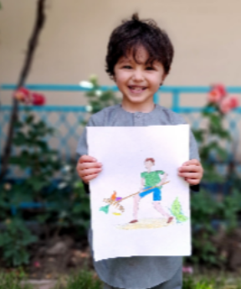
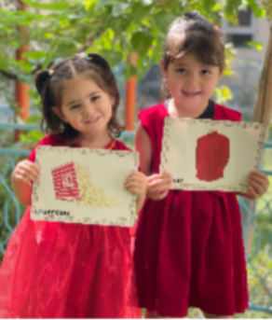
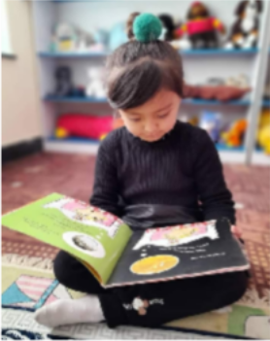



RESOURCES & ACHIEVEMENTS
Resources
Fully equipped ECD Resource and training centre
Highly trained and experienced trainers
Fully furnished ECD classes rooms.
Uninterrupted power supply and internet access
Teaching material and resource development expertise
Access to International ECD research, curriculum and teaching materials
Achievements {Since 2021}
491+ ECD Teachers trained (100% women)
41+ Private business enterprises created
5700+ Hour's trained & mentored
1500 + Children currently enrolled in our ECD canters
2000 + Children graduated from our ECD canters
Partners

Slide 7
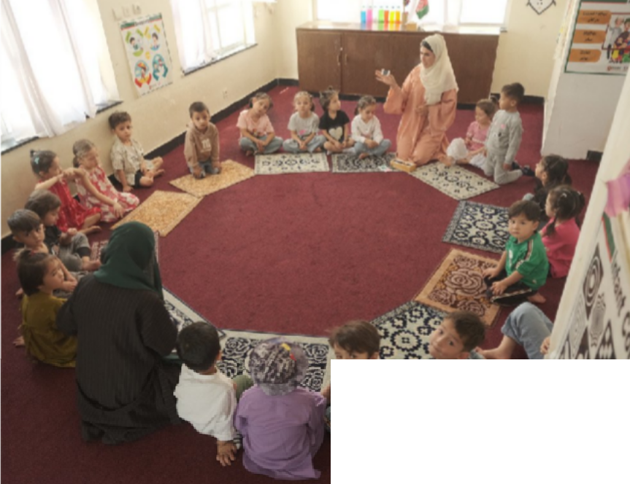
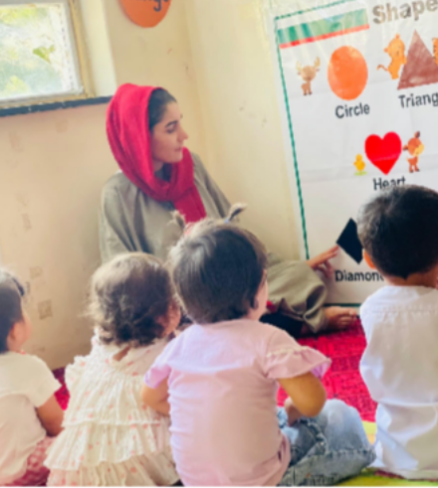
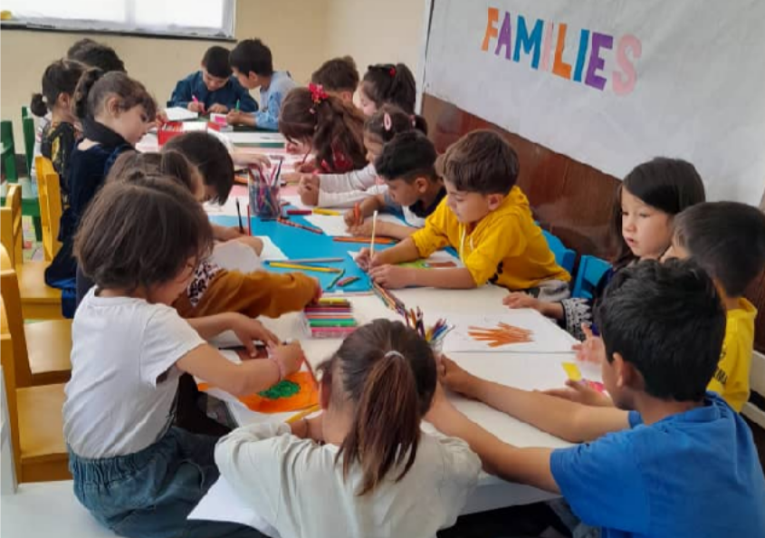
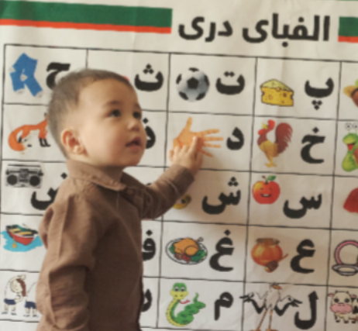
JOIN US IN BUILDING A STRONG FOUNDATION
The Nihāl Program is more than just education; it's an investment in the future of our communities. By supporting the cognitive, emotional, social, and physical development of our youngest children, we are building a generation of healthy, capable, and resilient leaders.
Be a Part of the Change.
Whether you are a parent, a community leader, a potential teacher, or a supporter, you can help us nurture the future.

Slide 8
Contact Us and Learn More:
Rupani Foundation - Nihāl ECD Program Website: www.rupanifoundationafg.org Email: info@rupanifoundationaf.org
Phone Number: +(93) 728623851-771887175
Address: House No 3. Street No 1. in-front of Millat Hospital, Taimani Prozha, Kabul.

